Slide 1
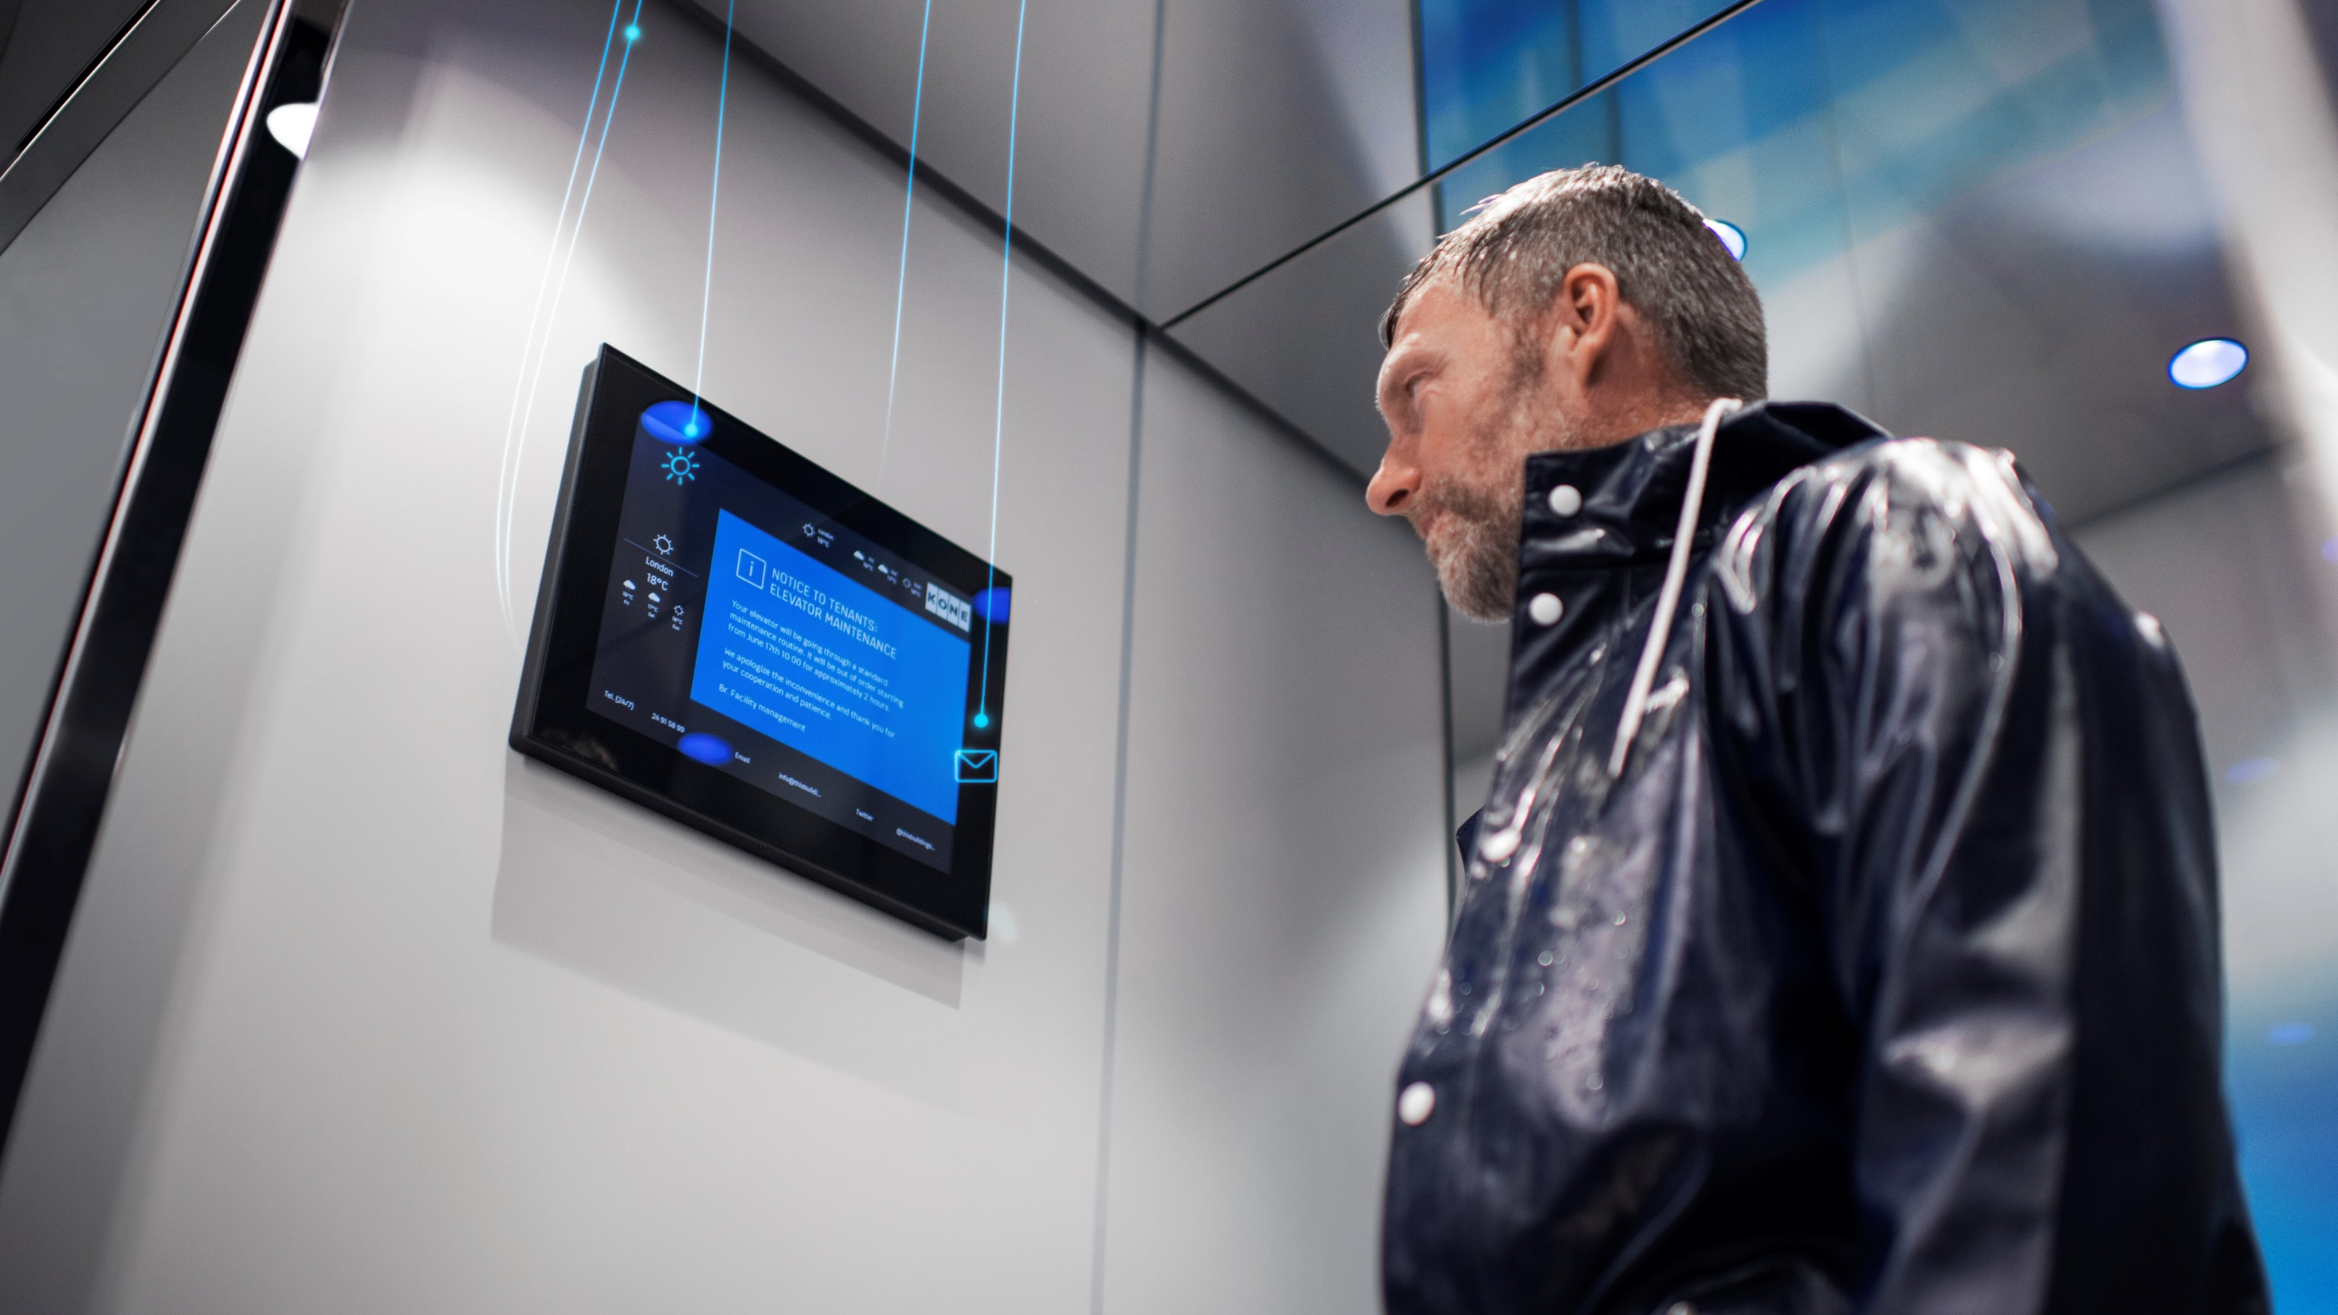
Redefining building communication with KONE Information
AUTHOR/DATE

Slide 2
KONE Information
KEEP EVERYONE IN THE LOOP
A simple yet flexible way to communicate with building users
Share targeted content via MediaScreens in elevators and MediaPlayers elsewhere in the building
Publish content quickly and easily to one or many locations from any PC with an internet connection – no more messy noticeboards, no more time-consuming manual updates
Define your content playlist by choosing from different apps and then publish immediately or schedule for later
After setup, one convenient monthly fee covers everything*
* Use of the Content Management Dashboard (unlimited users), software and security updates, and 24/7 monitoring of the solution. Each service package also includes a monthly mobile data allowance, suitable for typical usage.

Slide 3
KONE Information
Elevating building communication with Easy and efficient information sharing
Customer logo
Optional space for date, clock, and weather
Date, clock
Rolling content, publish via online portal
Weather, or tenant list
Building contacts, e.g. facility manager
Notes:
Lay out modification options

Slide 4
KONE Information
high-quality 15” mediascreen 300 comes as part of the solution
Wireless 4G connection
15’’ LCD display*
372 (W) x 296 (H) x 30.5 (D) mm
Connectivity and MediaPlayer embedded in the display
MediaScreen 300 requires a current KONE Information service contract.

Slide 5
KONE Information hardware options
KONE MediaScreen 300
A MediaScreen in your elevator allows residents to read important messages during their elevator ride. Can be installed in most KONE and non-KONE elevators.*
KONE MediaPlayer 300
A MediaPlayer solution in your lobby allows information to be shared on a big screen, replacing traditional noticeboards that have to be updated manually.
* Please see KONE Information technical information for elevator-platform related limitations
Notes:
Easy and efficient information sharing in elevators and in chosen building premises, such as lobbies, entrances and corridors.

Slide 6
KONE Information
Three service packages tailored to your communication needs
Features | Light | Standard | Premium
KONE content management system | ✓ | ✓ | ✓
Connectivity and data transfer* | ✓ | ✓ | ✓
Software and security updates | ✓ | ✓ | ✓
Facility manager messaging | ✓ | ✓ | ✓
Text and pictures | ✓ | ✓ | ✓
Weather |  | ✓ | ✓
RSS feed (For showing third-party news etc.) |  | ✓ | ✓
Traffic information |  |  | ✓
Social media (Facebook, Instagram, Twitter) |  |  | ✓
Included: Use of the Content Management Dashboard (unlimited users), software and security updates, 24/7 monitoring of the solution by KONE’s team.
* Each service package includes a monthly mobile data allowance, suitable for typical usage. Data usage exceeding the monthly allowance is invoiced to the customer in accordance with KONE’s current price list.
** RSS feed usage does not include any third-party licensing fees, these would need to be agreed separately between the customer and the content provider.

Slide 7
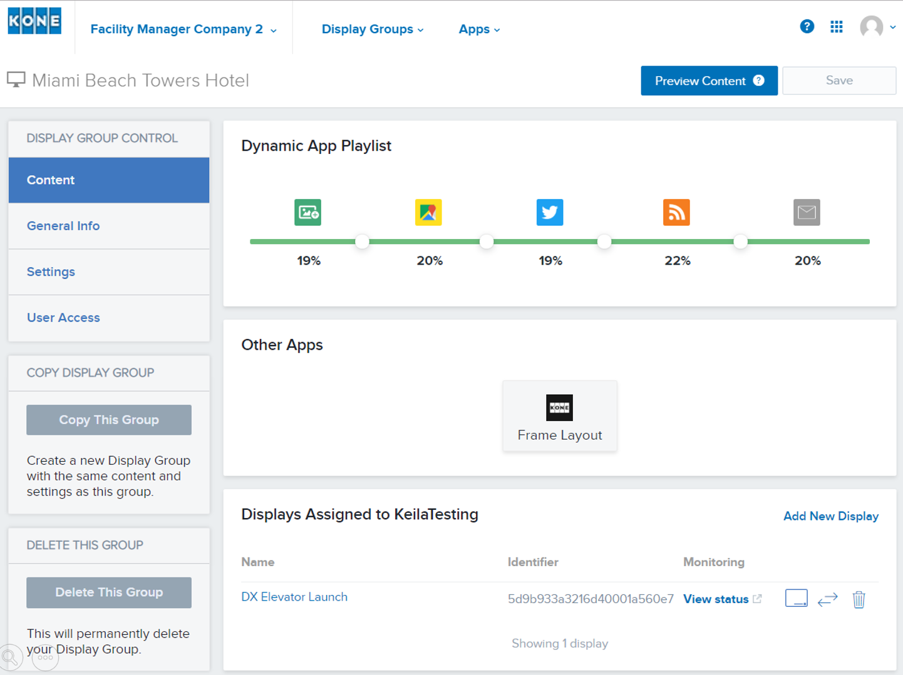
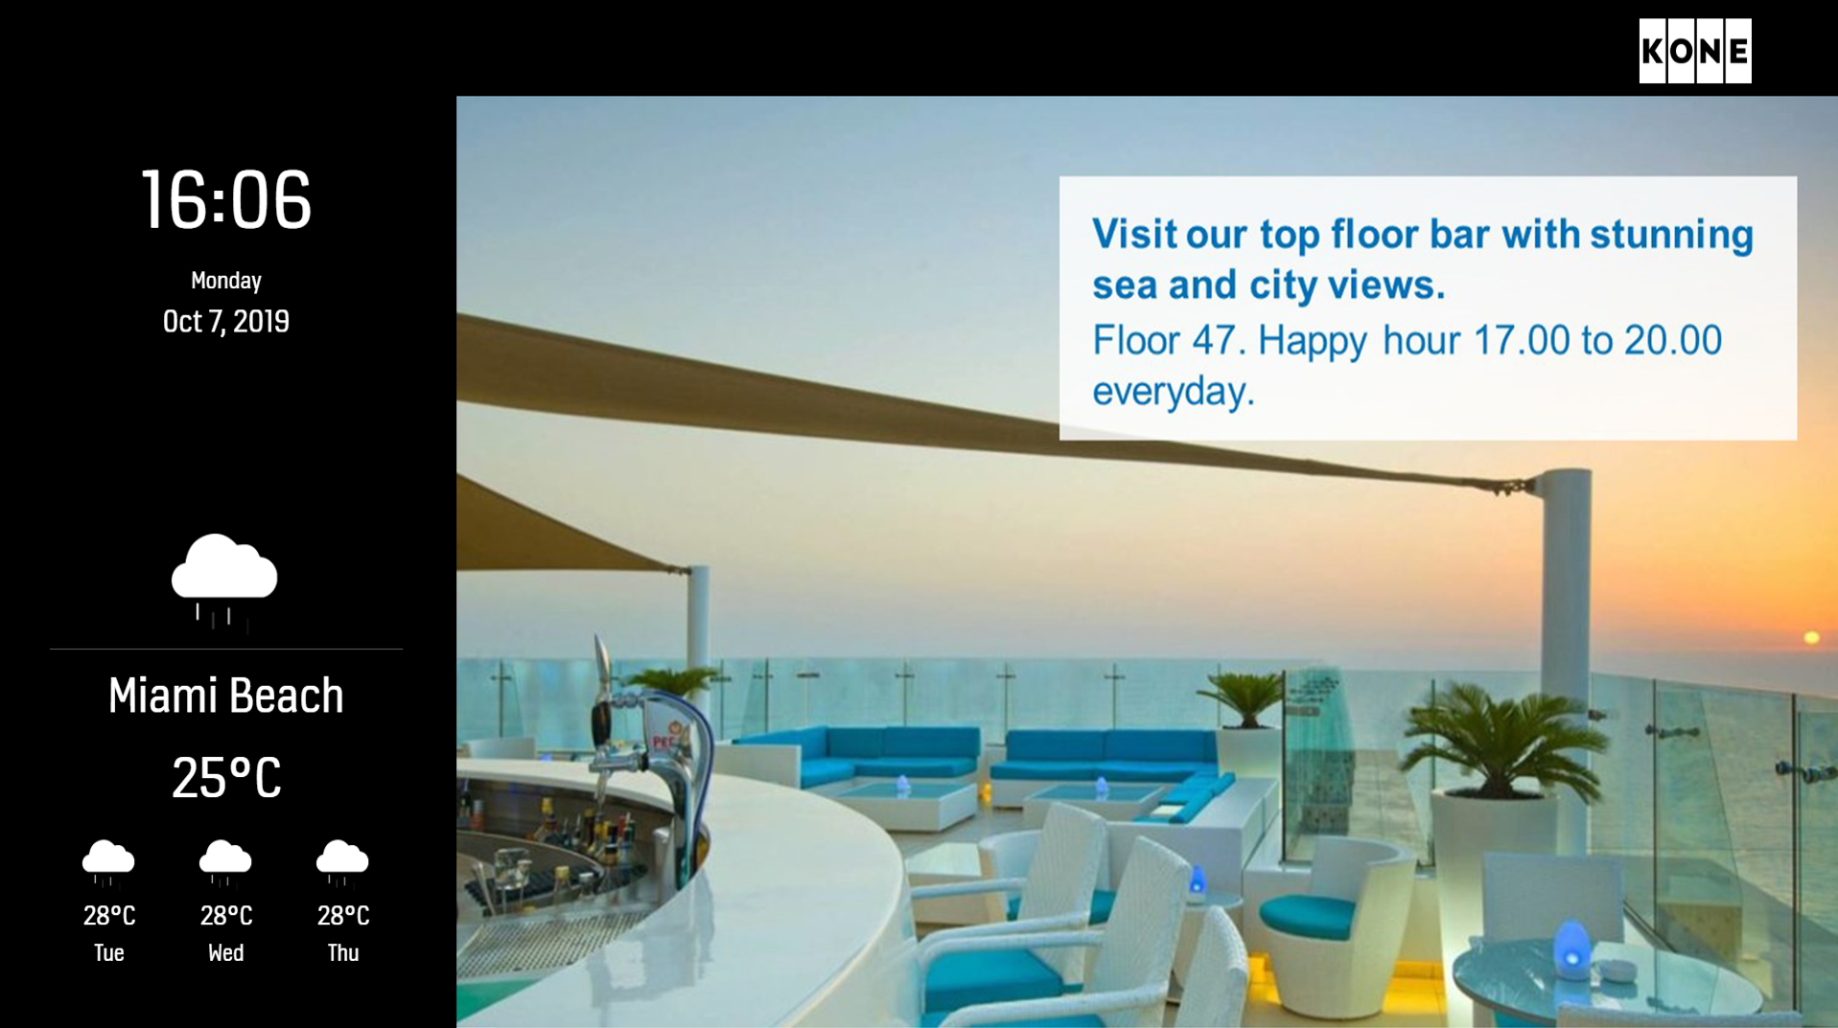
KONE Information
Customer role(S) are given online access to Content management dashboard to create playlists of apps. This determines what content to publish and when.
Content Management Dashboard
Example published content

